Slide 1

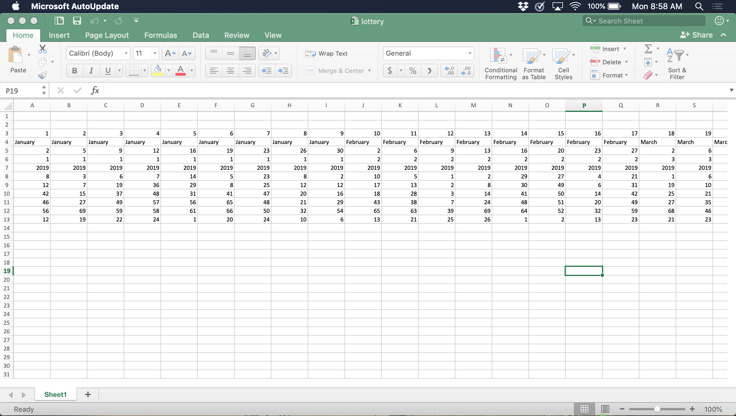
Lottery Number Generator
Contributor: Nicole Higgins https://github.com/ksu-is/NumberGenerator
Original Code: https://github.com/engineer1982/Machine-Learning-Lottery-Prediction
# of game
Month
Day of game
Number drawn (first → sixth)
Generate a sequence of numbers based on the database “[X,X,X,X,X,X]”

